Slide 1
Genetic Incompatibility Lab
BIO 240L Spring 2025
Tyler Gandee, Dr. Karen Barnard-Kubow, Caylin Murray,
Dr. Alfredo López-Caamal, and Dr. Laura Galloway
Notes:
Slides from: Using Nanopore sequencing to assemble and compare chloroplast genomes: introducing genomics and bioinformatics into the classroom. Tyler Gandee, Caylin Murray, Alfredo Lopez-Caamal, Isobel Cobb, Laura F. Galloway, Joseph A. Harsh, Karen B. Barnard-Kubow.

Slide 2
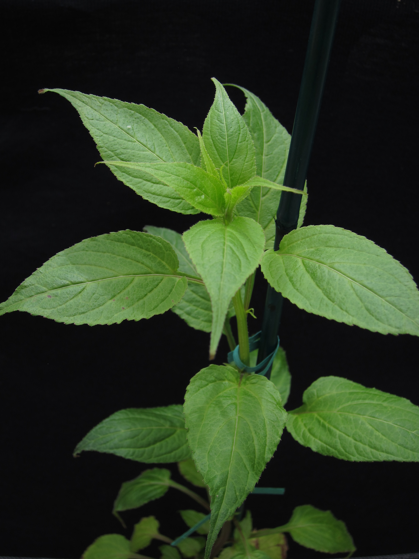
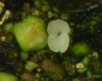
Speciation as a gradual accumulation of genetic incompatibility and thus reproductive isolation
What are the ecological and evolutionary processes that drive this process?

Slide 3
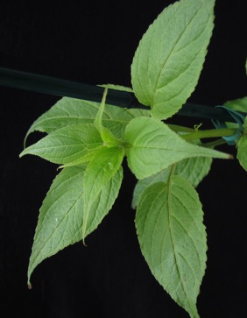
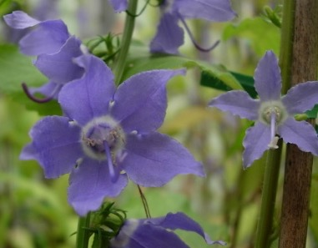
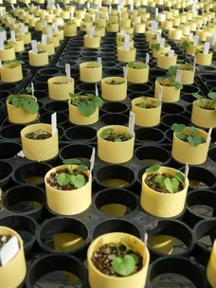
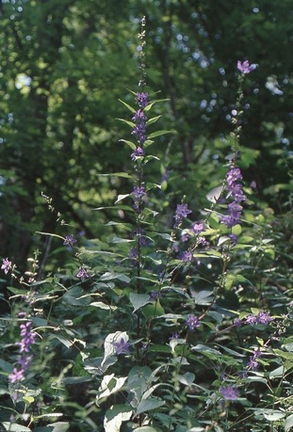
Campanula americana
(American Bellflower)
Notes:
Change to Campanula americana

Slide 4
Appalachian
Western
Western
Appalachian
What changes in the chloroplast genome cause this genetic incompatibility?
☺
☹

Slide 5
Is there a relationship between extent of structural variation in the chloroplast genome in C. americana and strength of genetic incompatibility?
Our approach
Cross plants from different genetic lineages
Germinate the seeds and score the strength of genetic incompatibility
Extract DNA from the parental plants and sequence the full chloroplast genome
Assemble the chloroplast genome de-novo
Compare de-novo assemblies from parental plants to score number of structural variants
Graph strength of genetic incompatibility against number of structural variants to determine if there is a relationship

Slide 6
Is there a relationship between extent of structural variation in the chloroplast genome in C. americana and strength of genetic incompatibility?
Our approach
Cross plants from different genetic lineages
Germinate the seeds and score the strength of genetic incompatibility
Extract DNA from the parental plants and sequence the full chloroplast genome
Assemble the chloroplast genome de-novo
Compare de-novo assemblies from parental plants to score number of structural variants
Graph strength of genetic incompatibility against number of structural variants to determine if there is a relationship

Slide 7
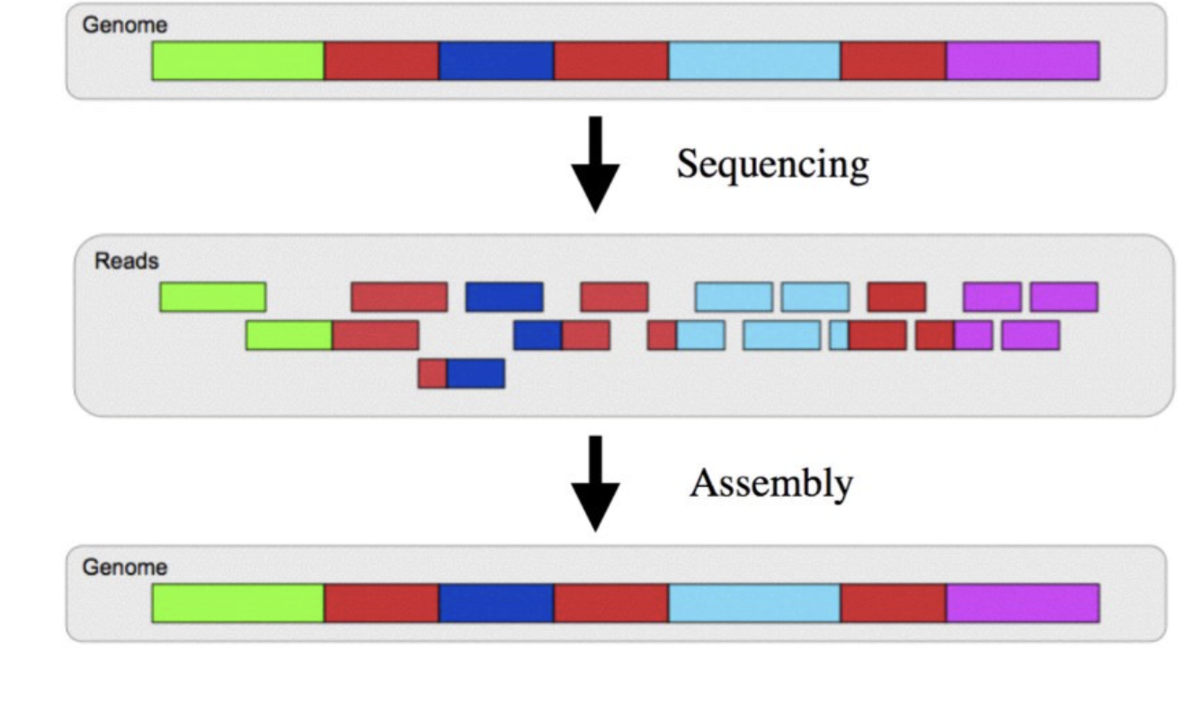
Genome sequencing: assembly
Many copies of the genome were sequenced
Different copies of the genome break/fragment in different places
Some reads will overlap
Computationally identify overlapping regions from each sequencing read
Assemble reads to form contigs
Ideally, one contig for the chloroplast/plastid genome

Slide 8
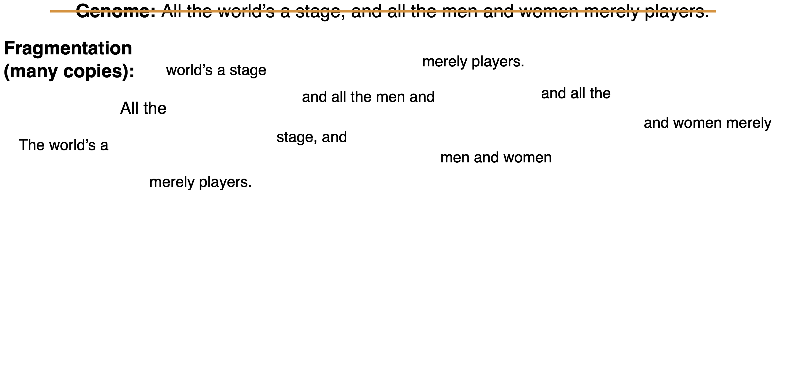
Genome sequencing: assembly

Slide 9
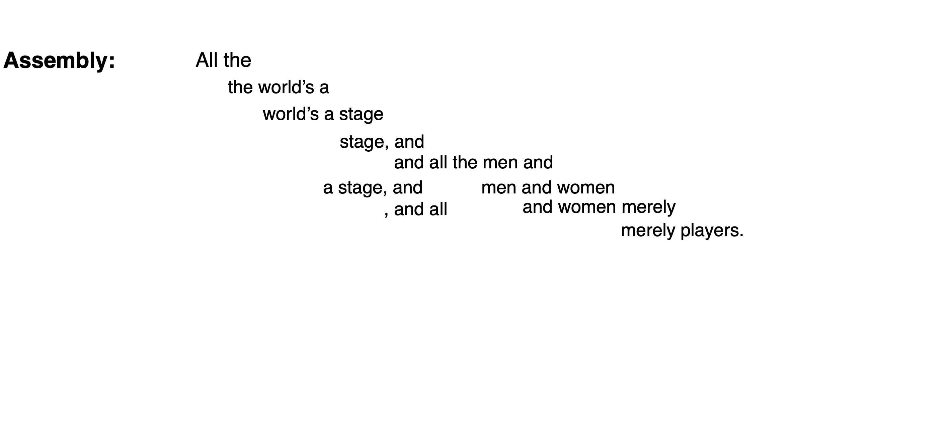
Genome sequencing: assembly

Slide 10
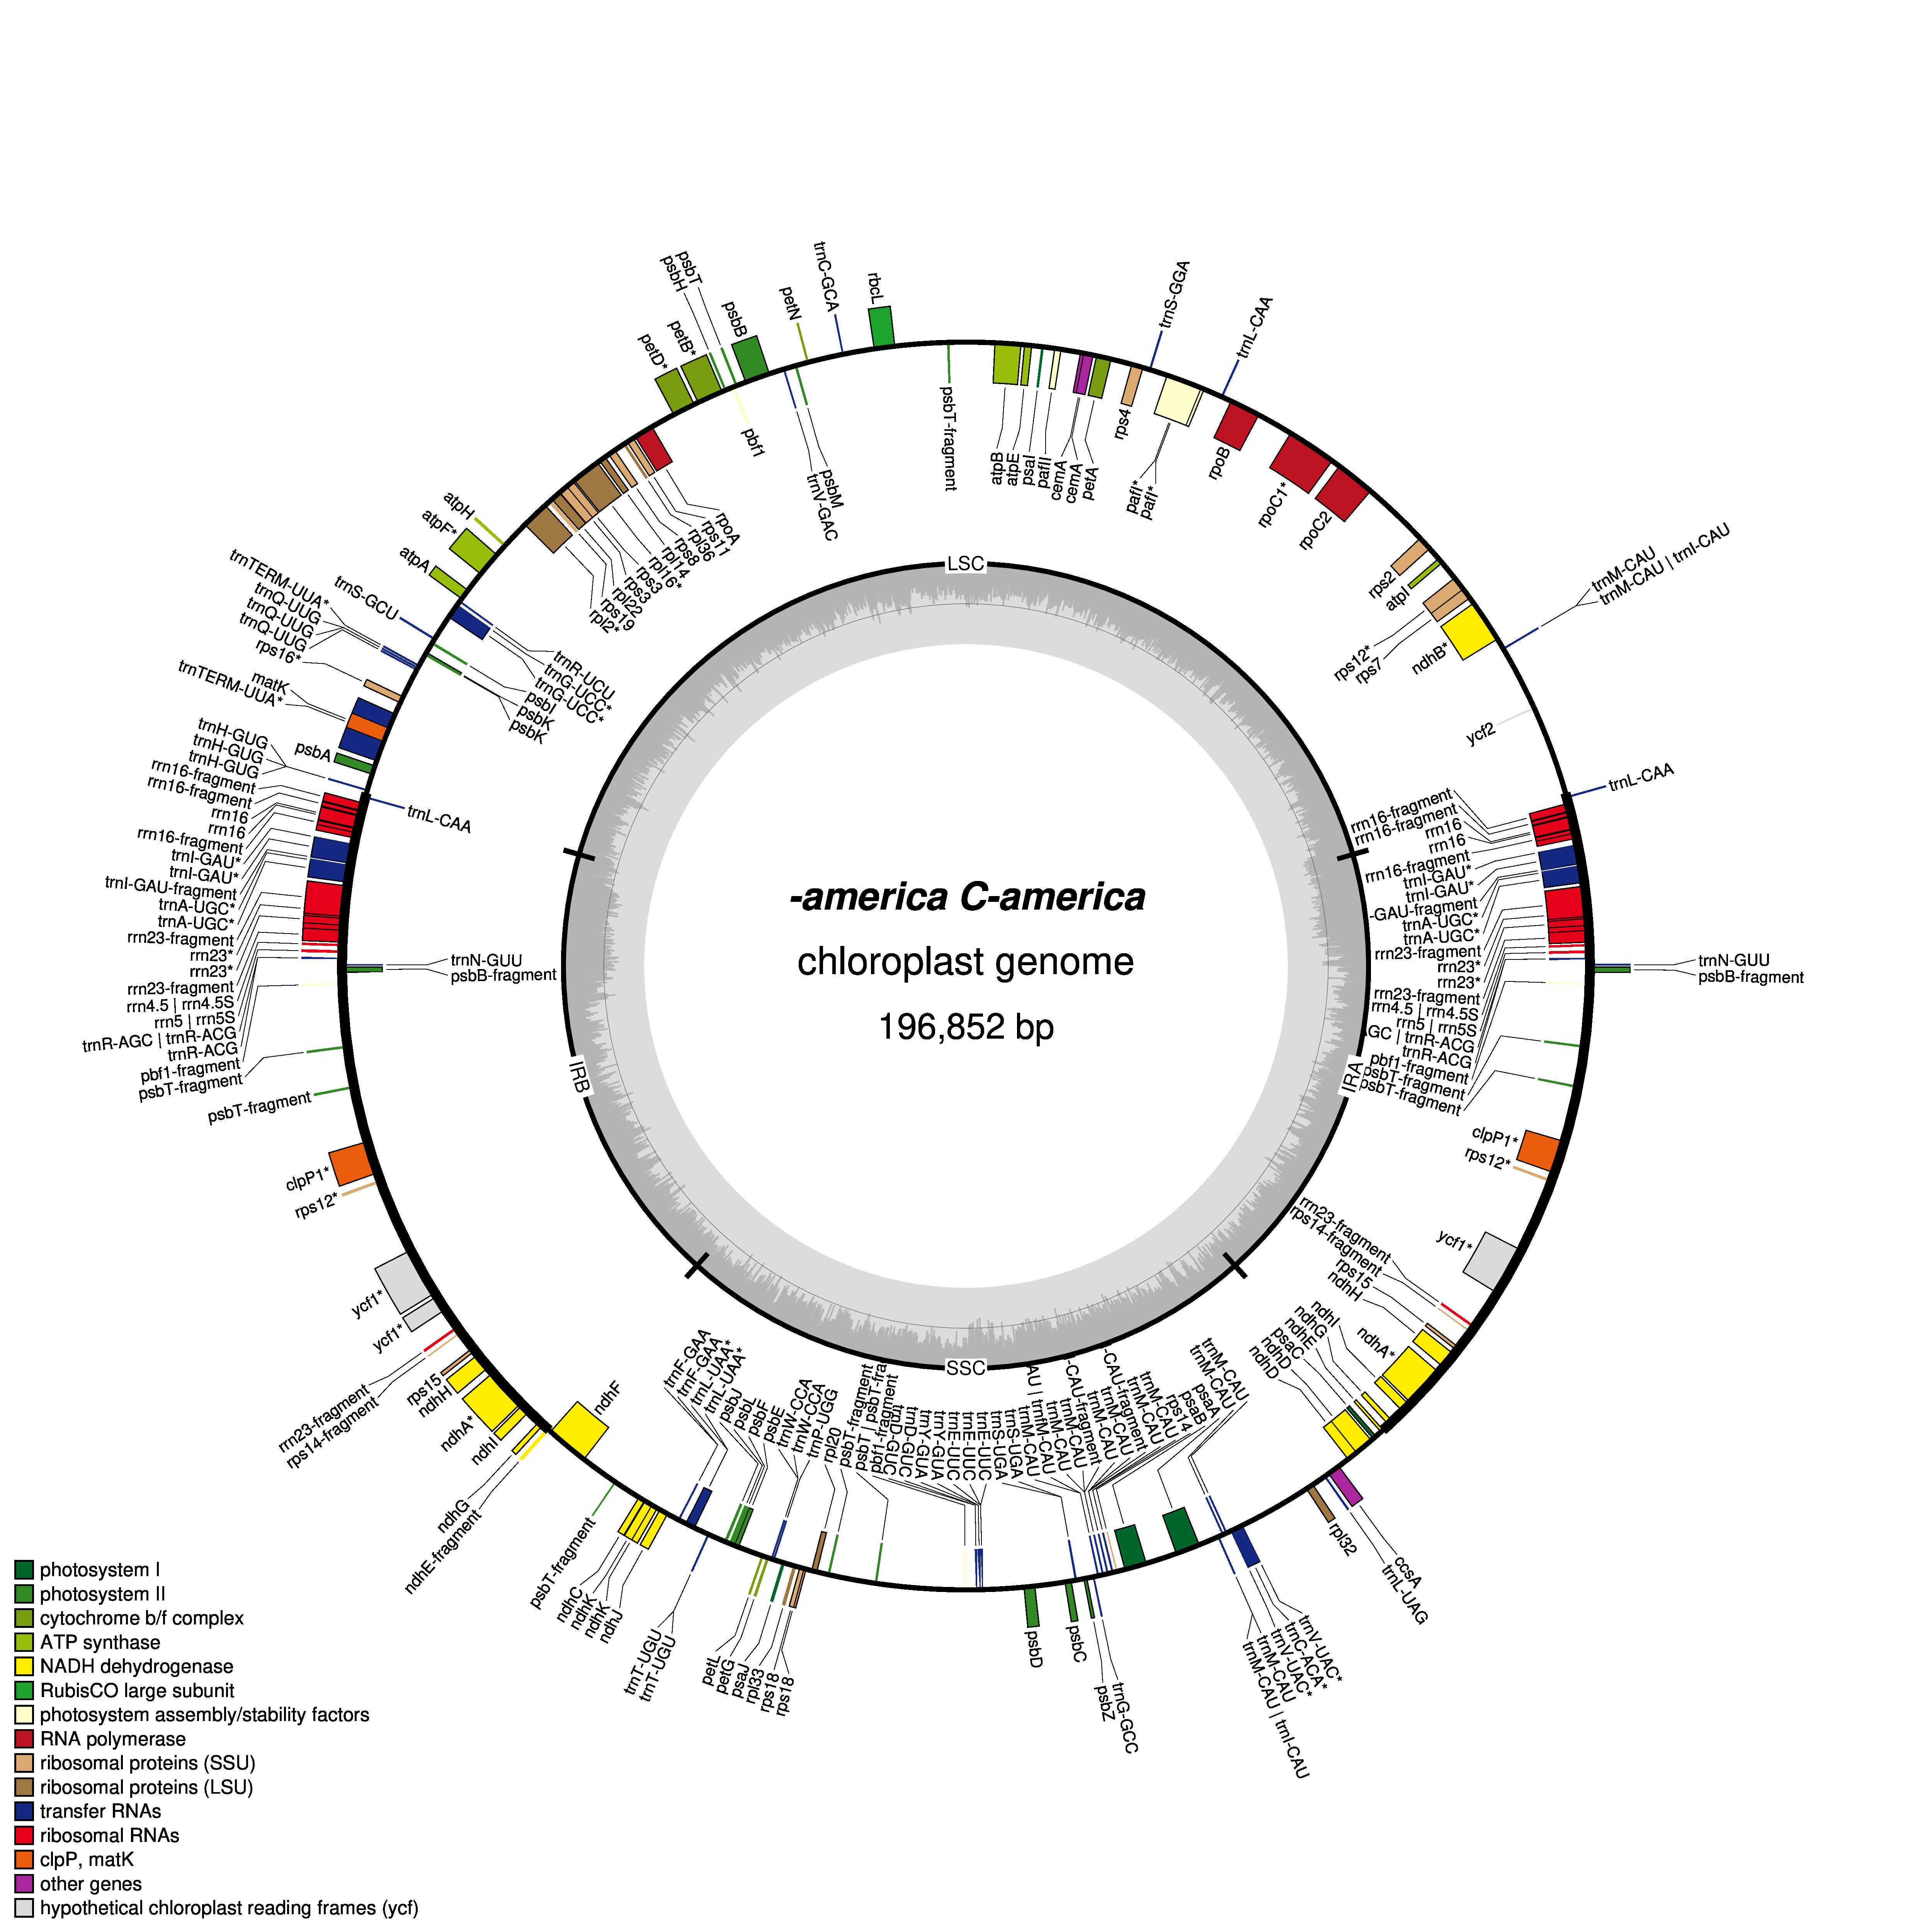
Genome sequencing: assembly
Campanula americana

Slide 11
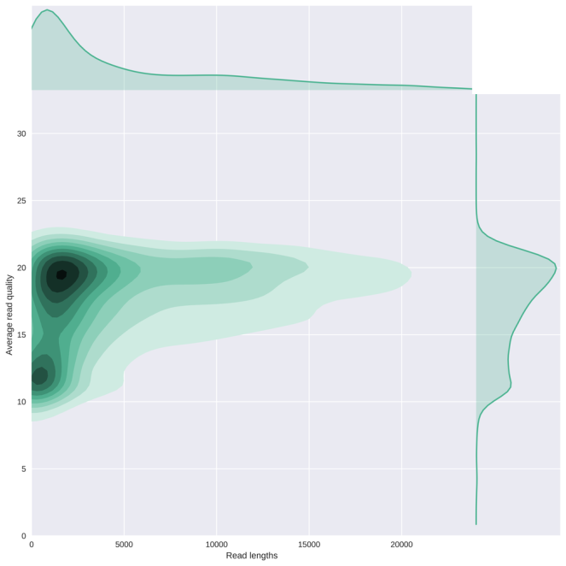
Our approach – using bioinformatics to assemble the chloroplast genome
Basecalling and mapping to chloroplast genome to pull out chloroplast reads
Will be done outside of lab
Quality control using Nanoplot
Distribution of read length, read quality

Slide 12
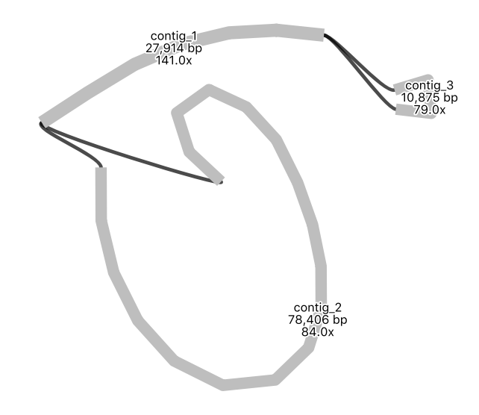
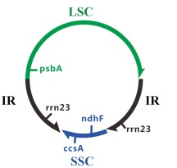
Our approach – using bioinformatics to assemble the chloroplast genome
Basecalling and mapping to chloroplast genome to pull out chloroplast reads
Quality control using Nanoplot
Distribution of read length, read quality
Genome assembly using Flye
How many contigs/pieces? What lengths?
Visualize assembly using Bandage
Do reads support contigs/pieces being connected?

Slide 13
Our approach – using bioinformatics to assemble the chloroplast genome
Basecalling and mapping to chloroplast genome to pull out chloroplast reads
Quality control using Nanoplot
Distribution of read length, read quality
Genome assembly using Flye
How many contigs? What length?
Visualize assembly using Bandage
Do reads support contigs connecting?
Annotation using GeSeq
Campanula americana

Slide 14
Is there a relationship between extent of structural variation in the chloroplast genome in C. americana and strength of genetic incompatibility?
Our approach
Cross plants from different genetic lineages
Germinate the seeds and score the strength of genetic incompatibility
Extract DNA from the parental plants and sequence the full chloroplast genome
Assemble the chloroplast genome de-novo
Compare de-novo assemblies from parental plants to score number of structural variants
Graph strength of genetic incompatibility against number of structural variants to determine if there is a relationship

Slide 15
Our approach – comparing assemblies to score structural variation
Use Mummer/nucmer to align and compare two genome assemblies
Compare your group’s assembly to another group’s assembly
Use Assemblytics to examine the two-genome alignment and score structural variants

Slide 16
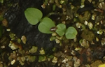
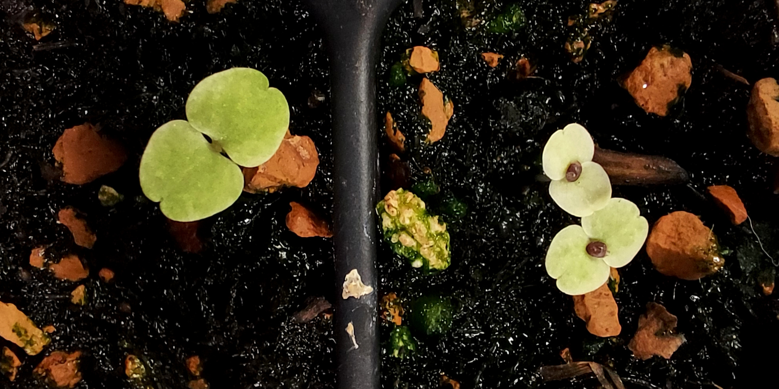
Phenotyping Seedlings
Green: Compatible (None)
Yellow: Moderate incompatibility
White: High incompatiblility
Complication
Chloroplast inheritance is not always maternal
If you see a mix of green and white seedlings, green is likely paternal inheritance
Score most incompatible seedlings observed

Slide 17
What relationship do you expect?
Strength of genetic incompatibility
Number of structural variants

